Slide 1

WAY TO ENTERPRISE
AWS
VTI ACADEMY
Author: duy.nguyenngoc1@vti.com.vn

Slide 2
Agenda
Certificate Manager Service
Key Management Service
Copyright © VTI Academy All Rights Reserved

Slide 3
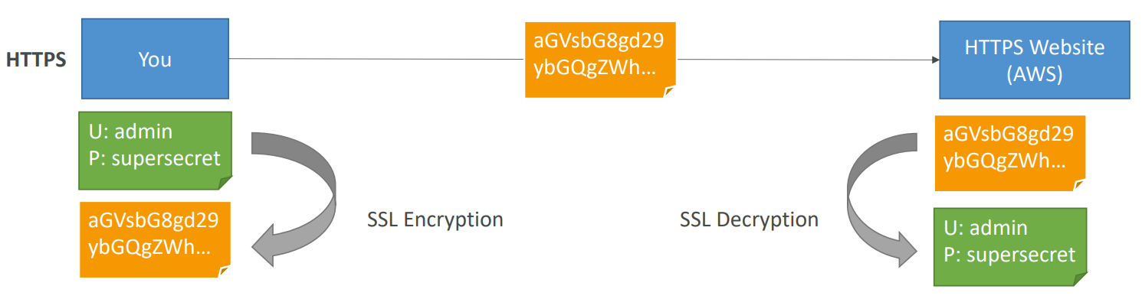
Encryption
Encryption in flight (SSL)
  Data is encrypted before sending and decrypted after receiving
  SSL certificates help with encryption (HTTPS)
  Encryption in flight ensures no MITM (man in the middle attack) can happen
  2 types: SSL (Old), TLS

Slide 4
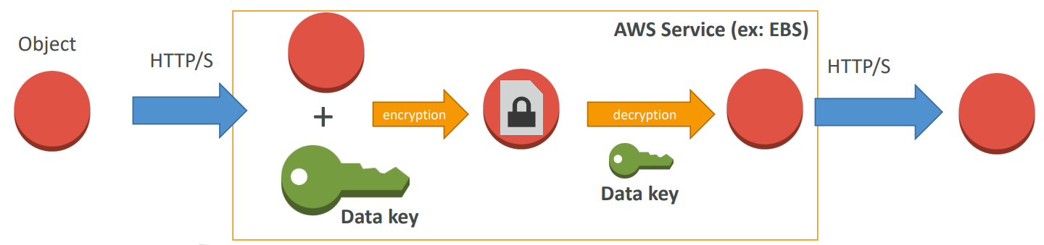
Encryption
Server side encryption at rest
  Data is encrypted after being received by the server
  Data is decrypted before being sent
  It is stored in an encrypted form thanks to a key (usually a data key)
  The encryption / decryption keys must be managed somewhere and the server must have access to it

Slide 5
Assignment
  Self-practice

Slide 6
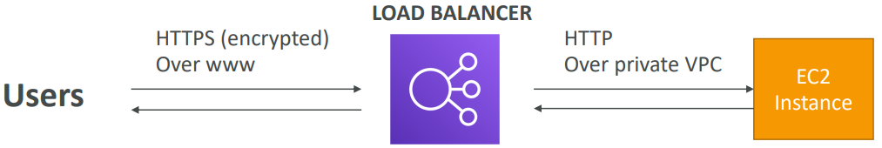
Certificate Manager Service
Is a service that allows easily provision, manage, deploy public and private SSL/TLS certificates
2 types: public certificates & private certificates
Integrate with other AWS services: ELB, CloudFront, API Gateway, ...
Price: free for public certificates - https://aws.amazon.com/certificate-manager/pricing
Tutorial: https://docs.aws.amazon.com/acm/latest/userguide/acm-overview.html

Slide 7
Certificate Manager Service
Demo
  https://www.youtube.com/watch?v=bWPTq8z1vFY

Slide 8
Assignment
  Self-practice

Slide 9
Key Management Service
Is a service that allows management of keys, keys are used to encrypt data on the server side
Regional Service
Integrate with other AWS services to perform at-rest encryption (Ex: S3, RDS, EBS, …)
Usecases: Encryption & decryption data, Signin & verification
Price: https://aws.amazon.com/kms/pricing
Tutorial: https://docs.aws.amazon.com/kms/latest/developerguide/overview.html

Slide 10
Key Management Service
Demo
  Create key
  Test

Slide 11
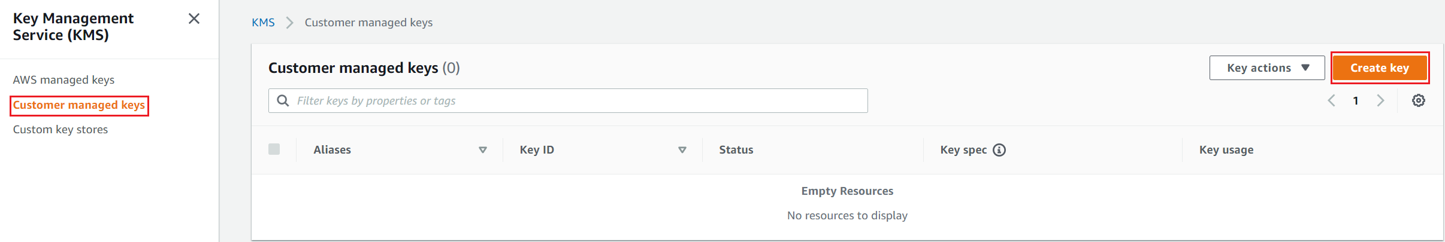
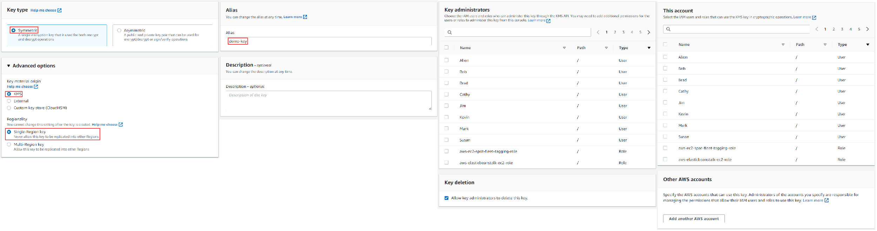
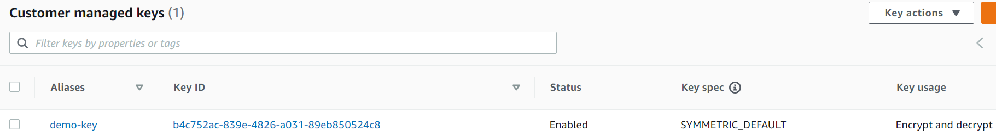
Key Management Service
  Create key

Slide 12
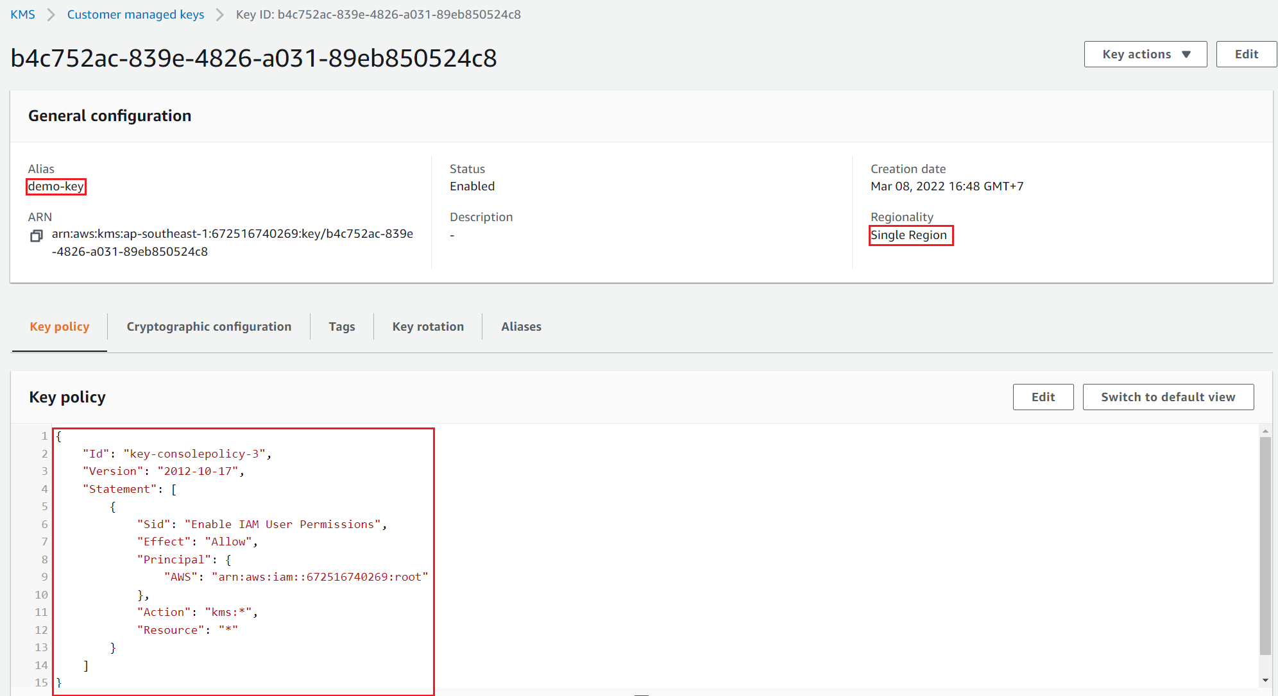
Key Management Service

Slide 13
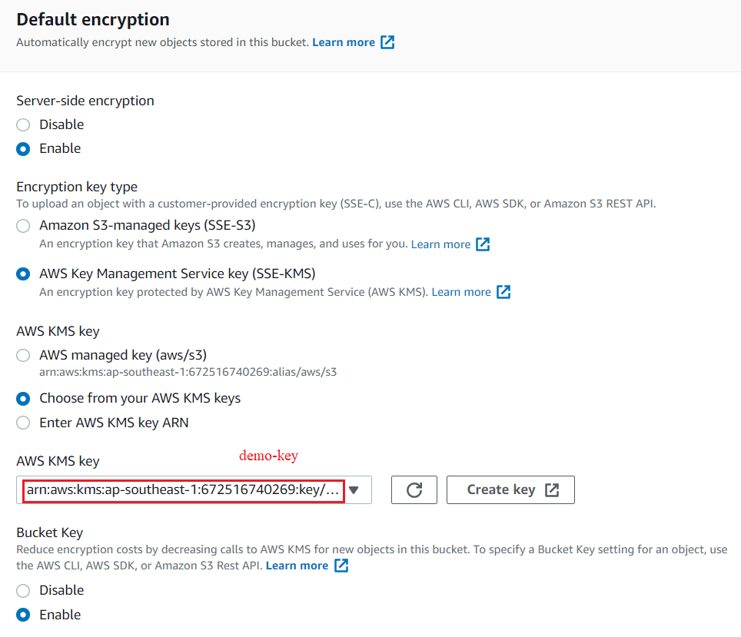
Key Management Service
  Test
Create S3 Bucket

Slide 14
Assignment
  Self-practice

Slide 15
Key Management Service
Components
  Key

Slide 16
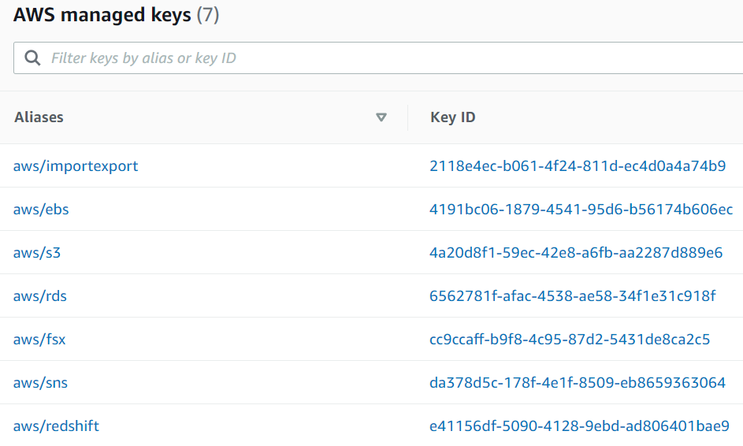
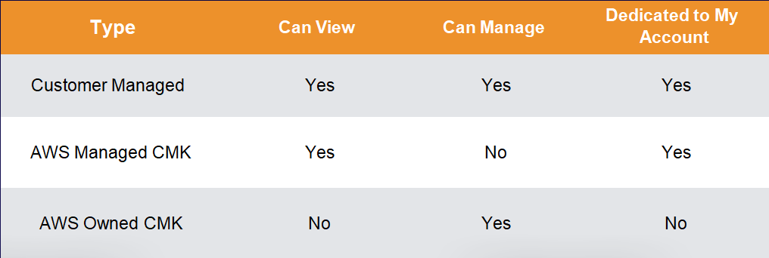
Key Management Service
  Key
    AWS managed keys: AWS will manage the key, Free
    Customer managed keys (CMKs): Customers create and manage keys, saved in CloudHSM, 1$/month
    AWS owned keys: list of keys for AWS service to manage for using the service on multiple accounts, Developers cannot see

Slide 17
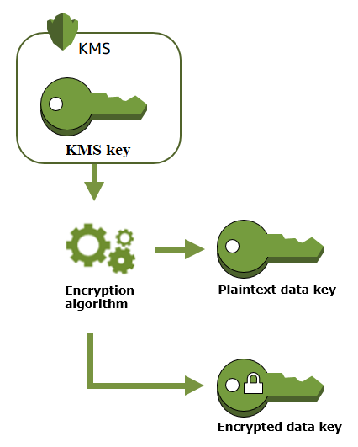
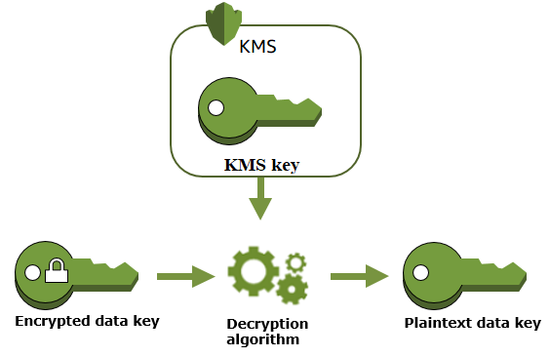
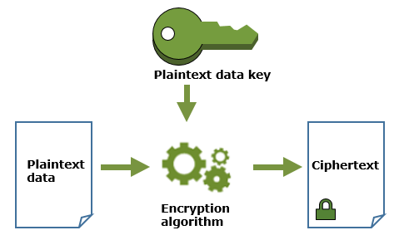
Key Management Service
    2 types
      Symmetric (Default): a key is used for both encryption & decryption
Create key
Encrypt data
Decrypt data

Slide 18
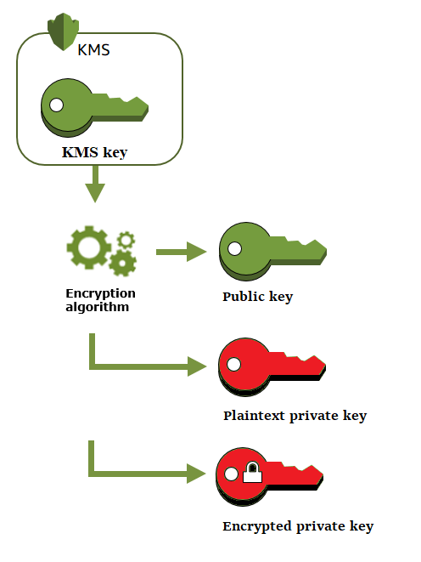
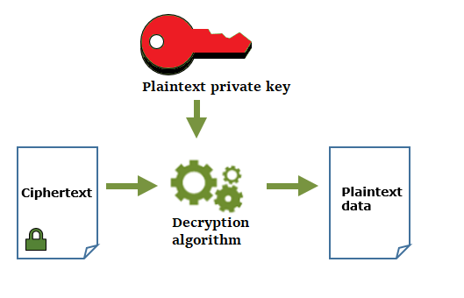
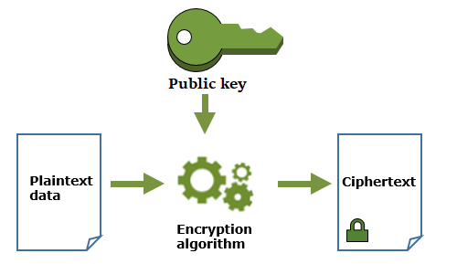
Key Management Service
      Asymmetric: a public key and private key pair (RSA key pair) used for signin & verification or encryption & decryption
Create key
Encrypt data
Decrypt data

Slide 19
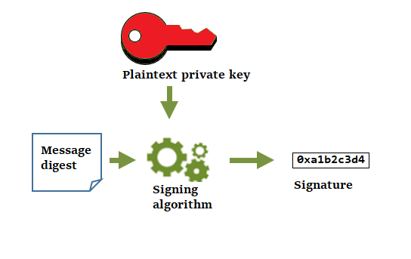
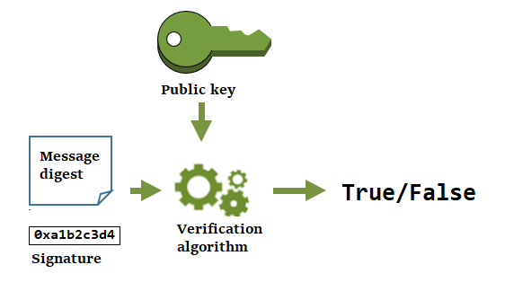
Key Management Service
Sign messages
Verify a signature

Slide 20
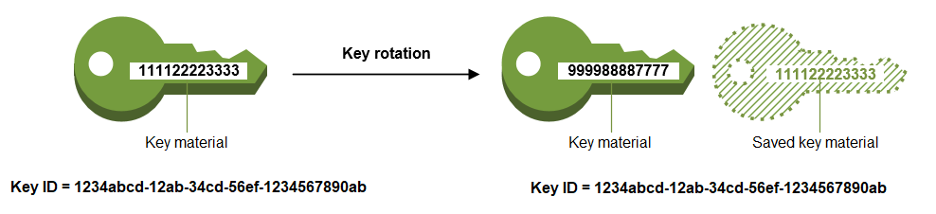
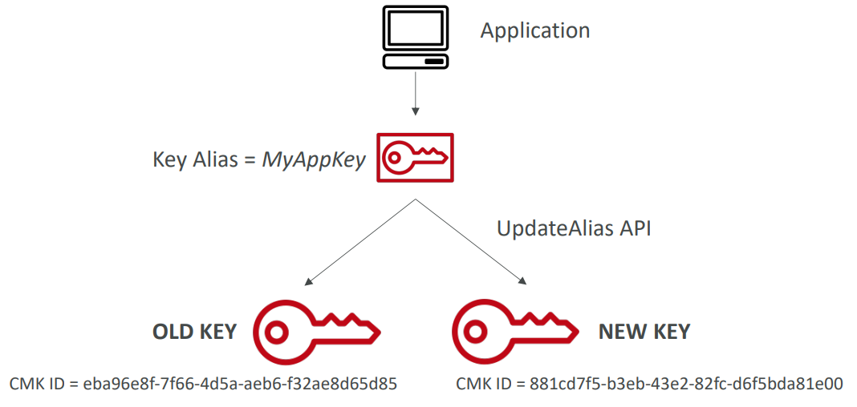
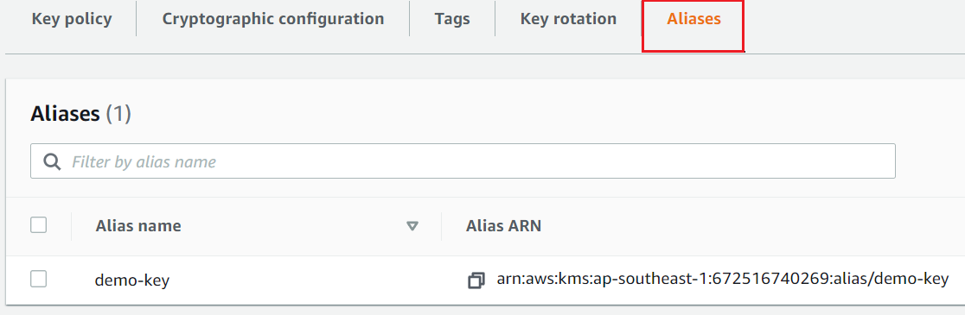
Key Management Service
    Rotate key
      Key ID, Key ARN, Region, policies, permission will not change
      You can set automatic key rotation by year
    Alias
      To hide the change of key for the application

Slide 21
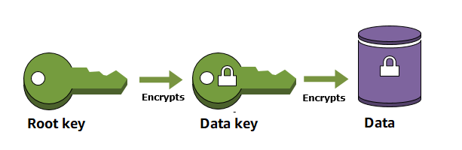
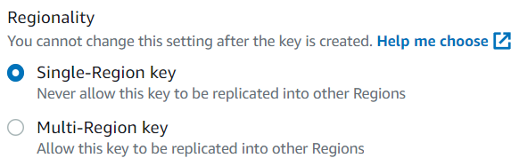
Key Management Service
    Envelope encryption: encrypt key (not for data)
    Support multi-region
    There are 3 places to store keys
      KMS
      External: Customers save keys
      Custom key store: Save on CloudHSM
Envelope encryption
Support multi-region

Slide 22
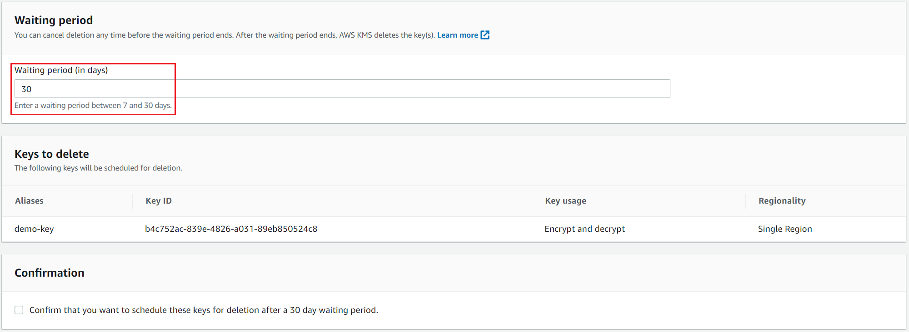
Key Management Service
    Key Delete Protection

Slide 23
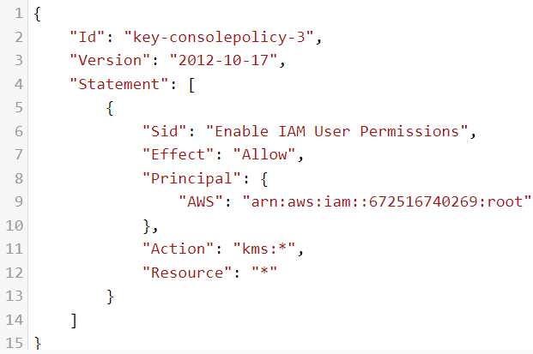
Key Management Service
    Key policy
      Integration with IAM Service to control access and use of keys
      By default, root user has full rights
      It is possible to set up for other accounts to also manage the key
https://aws.amazon.com/blogs/security/how-to-use-kms-and-iam-to-enable-independent-security-controls-for-encrypted-data-in-s3/

Slide 24
Assignment
  Self-practice

Slide 25
Summary
KMS is a service that allows management of keys, keys are used to encrypt data on the server side (at rest)
Integrate with other AWS services to perform at-rest encryption (Ex: S3, RDS, EBS, …)
Usecases: Encryption & decryption data, Signin & verification
3 types: AWS managed keys, Customer managed keys (CMKs), AWS owned keys
Symmetric, Asymmetric
3 places to store keys: KMS, External, Custom key store CloudHSM
Features: Rotate key, Alias, Support multi-region, Key Delete Protection, Key policy

Slide 26
Q & A
Copyright © VTI Academy All Rights Reserved

